Slide 1
Introduction to Reliability and Maintainability Engineering
Unit 7B
Spring 2022

Slide 2
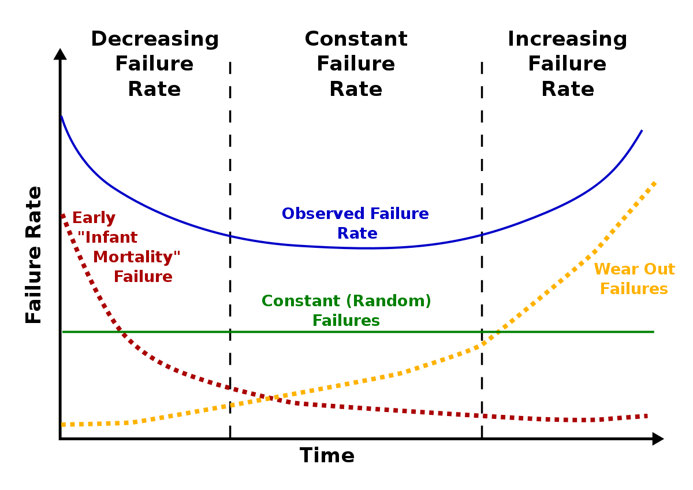
The ‘Bathtub Curve’
Component Life Behavior
Dominant failure mode depends on age.
λ(t) ~ λ
t
Notes:
A well known plot of a hazard rate function is the bathtub curve. It obviously gets its name from its shape. It suggests that for some items, early or infantile failures occur that decrease (DFR) with age as design and manufacturing problems are recognized and corrected. This is followed by a period of nearly Constant Failure Rates (CFR) in which most failures are a result of external random occurrences. Can you suggest what probability distribution may best describe this period? Finally, as the component ages and wearout begins to dominate, an IFR is observed. It is not clear how many components actually behave in this manner. Certainly some do. All three failure modes may be continuously present; however, the dominate failure mode depends upon the age of the component.

Slide 3
Example: Human Mortality Curve
λ(t)
Ebeling, 2010

Slide 4
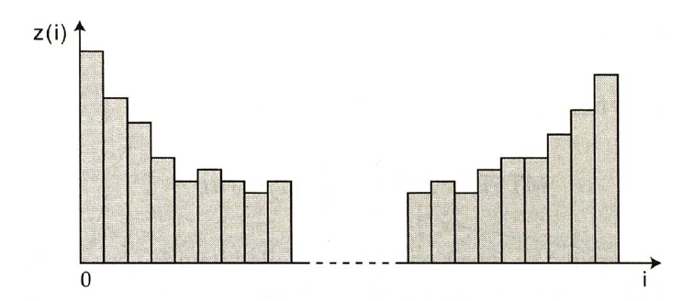
Bathtub Curve from Tests

Slide 5
More on the Bathtub Curve
Burn-in Useful Life Wear-out
Characterized by DFR CFR IFR
Caused by
Manufacturing defects Environment Fatigue
Welding flaws, Cracks, Random loads Corrosion Defective parts Human error Aging
Poor quality control, Unknown Friction
Contamination, Chance events Cyclical loading Poor workmanship
Reduced by
Burn-in testing Redundancy Preventive Maintenance
Screening Excess strength Predictive Maintenance
Quality control Parts replacement
Notes:
Some more insight on the bathtub curve. The design techniques used to mitigate failures will be discussed in more detail later.

Slide 6

λ is a constant: λ(t)= λ
When λ is a constant, it means that the failure rate is not changing with time. The failure rate is constant (flat part of bathtub curve).
Then, reliability at time t:
If λ is non constant, the rate of failure (i.e. the number of failures you will observe over a given time) changes with time. You will then have to insert λ’s expression and integrate over time t.
$$R\left(t\right)=e^{−\int_{0}^{t}{λdt}}=e^{−λt}$$
(for λ=constant)

Slide 7
Average Failure Rate (AFR)
For failure distributions that are increasing or decreasing (IFR or DFR), the conditional failure (or hazard) rate is a function of time and is continuously changing.
For comparison purposes, it is useful to compute an average conditional failure rate for particular time intervals.
So, two or more components having different failure distributions can be compared, based on their average conditional failure rate over the same time interval.
where
Notes:
For failure distributions that have either IFR and DFR characteristics, the failure rate (hazard rate) is a function of time and is continuously changing. For comparison purposes, it is sometimes useful to compute an average failure rate for some interval of time. This way, two components having different failure distributions can be compared based upon their average failure rate over the same time interval.

Slide 8
Ex: Average Conditional Failure Rate over 5 yr, t₁ = 0
Often t₁ = 0.
Then, lnR(t=0) = ln(1) = 0, so AFR(0,t) = AFR(t) = -ln R(t) / t
For a component with
where a = 10 yr represents the maximum lifetime
t₁ = 0, t₂ = 5
AFR(0,5 yr) = - ln [1 - 0.25] / 5 = 0.056 failures / yr
Average conditional failure rate over 0 to 5 yr
Notes:
Let’s find the average failure rate for our example.

Slide 9
Conditional Reliability
Probability that a component will not fail to time T₀ + t given the Pr it has survived to time T₀ is calculated from a ratio of the two unconditional reliabilities at T₀ + t and T₀ .
Logic expression:
Notes:
Another useful concept is conditional reliability. Conditional reliability is the probability that a component will survive to time T₀ + t given that it has survived to time T₀. In other words, given that the component has aged to time T₀ how likely is it that it will continue to operate for an additional time t. A conditional reliability can be found by forming the ratio of two unconditional reliabilities. Do you see how this result is obtained by using some basic rules of conditional probabilities? Conditional reliabilities are useful in analyzing equipment burn-in periods and manufacture warranty periods.

Slide 10
Residual Life or Conditional MTTF
The residual life is the expected remaining life of a component, given the Pr of its survival to time T = T₀.
The residual MTTF is the mean time to failure of a component, given the Pr it has not failed or is working at T = T₀.
, t’ = t + T₀
Note limits
Notes:
Using the conditional reliability function, a conditional or residual MTTF can be found. This is interpreted as the mean remaining life of a component that has aged to time T₀. You should understand how to use this formula; however, the definite integral must often be found numerically.

Slide 11
R(t) = 1-t²/100: Conditional
What is the reliability after 5 years, given that the equipment was working at end of 1 yr?
Conditional Reliability
Therefore for T₀ = 1 (Pr of working), and t = 5 (additional time): R(5|1) = 1.01 – 36/99 = 0.65
For unconditional reliability, R(5) = 1 – 0.25 = 0.75.
Is this result reasonable?
Notes:
For our example, we can easily compute a conditional reliability and, at least in this case, solve for the residual MTTF. How does the MTTF(1 year) compare to the unconditional MTTF? Does this make sense?

Slide 12
Residual life
Residual MTTF, Residual life:
Compare the residual MTTF = 5.73 yr given Pr of working at T₀ = 1 to the unconditional MTTF of 6.67 yr.
Is this result reasonable?

Slide 13
Residual
MTTF(T₀)
T₀
Ebeling, 2010

Slide 14
Exercise #1
A panel consisting of analog displays has a reliability function given by R(t) = (200-t)/200 for 0 < t < 200, where t is measured in 1000 of hr. Find:
a. R(50) and R(12)
b. R(50 | 12)
c. MTTF, unconditional
d. MTTF(12) , conditional
Notes:
At last, an exercise for you to work. The solution is given on the next slide but don’t look until you have tried to solve it first.

Slide 15
Exercise #1- solution
R(t) = (200-t)/200
Unconditional:
a. R(50) = (200 - 50)/200 = 0.75
R(12) = (200 - 12)/200 = 0.94
b. R(50|12) = R(62) / R(12) = [(200 - 62) /200] /0.94 = 0.69 / 0.94 = 0.734
Conditional:
Notes:
Did you get the correct answers? If not, go back and review the material that was missed. If you had trouble with the math, review some algebra and calculus. If you don’t understand the solution, contact your instructor.

Slide 16
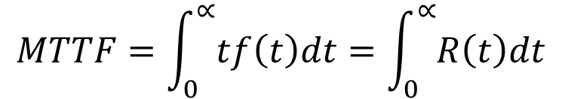

Exercise #1- solution
R(t) = (200-t)/200
Conditional:
Unconditional:
$$MTTF=\int_{0}^{∝}{tf\left(t\right)dt}=\int_{0}^{∝}{R\left(t\right)dt}$$
Unconditional:
$c. MTTF=\int_{0}^{200}{1−\frac{t}{200}}dt=[t−\frac{t^{2}}{400}]_{0}^{200}$=100
Conditional:
< 100
T₀
This result is expected due to monotonic decrease in conditional MTTF.

Slide 17
Exercise #1 (continued)
What is the shape of the pdf, f(t)?
Is the failure rate function λ(t) =f(t)/R(t) increasing or decreasing?
Compute the average conditional failure rate over the first 100,000 miles, AFR(100) = -lnR(t)/t₂ , t₁ = 0, t₂ = 100,000 mi
Notes:
Some more of Exercise #1.

Slide 18
Exercise #1 - Solution
e. f(t) = -dR(t) /dt
= - d {(200-t)/200}/dt = 1/200
f(t)
t
200
Sketch
f.
t
200
g. AFR(100) = -lnR(t)/t = - ln {(200-100)/200} / 100
= 0.007 failures/ 1000 mi.
Ebeling, 2010
Notes:
Did you get the correct answers this time? If not, go back and review the material that was missed. If you had trouble with the math, review some algebra and calculus. If you don’t understand the solution, contact your instructor.

Slide 19
Student Practice Exercise
Insulators on a power distribution system have a reliability function with t measured in yr.
R(t) = 1 / (1 + 0.05t) where t ≥ 0
Find:
a. F(1 yr) and R(2 yr)
b. R(2|1) = R(t+T₀)/R(T₀)
c. The hazard rate function
d. AFR(3)
Notes:
Let’s try a second example.

Slide 20
Student Practice Exercise- Solution
a. F(1) = Pr{T<1} = 1 - 1/[1+0.05(1)] = 1 - 0.9524 = 0.0476
R(2) = Pr{T>2} = 1/[1+0.05(2)] = .9091
b. R(2|1) = Pr{T>3 | T>1} = R(3) / R(1)
= [1+0.05(3)]⁻¹ /0.9524 = 0.913
c. f(t) = -d [1+0.05t]⁻¹ /dt = 0.05[1+0.05t]⁻²
λ(t) = f(t)/R(t) = 0.05/[1+0.05t] which is DFR
d. AFR(3) = {-ln [1+0.05(3)]⁻¹ } / 3
= -ln 0.8696 /3 = 0.0466 failures per year.
Notes:
Isn’t it getting easier?

Slide 21
Exponential Distribution for Constant Failure Rate Region CFR
Given λ(t) = λ for T ≥ 0
Employing the relationship between the Reliability Distribution R(t) and the Conditional Failure Rate function λ(t), the basic expression for R(t) is
Understand that: Even though the failure rate λ here is constant with t, R(t) is dependent on t.
Notes:
We derive the exponential distribution by starting with the assumption that the hazard rate function is constant (CFR) and equal to lambda. Certainly this is the simplest assumption that can be made concerning the functional form of the hazard rate function. Then using the relationship between the reliability function and the hazard rate function presented in Chapter 2, the exponential reliability function is obtained. Check and see if this function has the properties of a reliability function! You do recall what those properties are, don’t you?

Slide 22
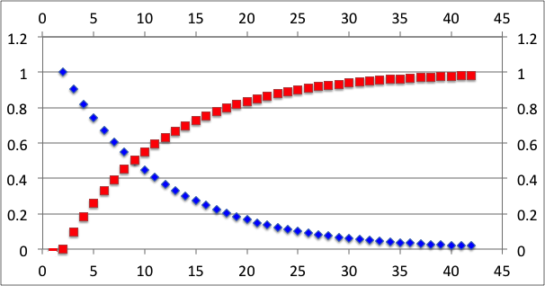
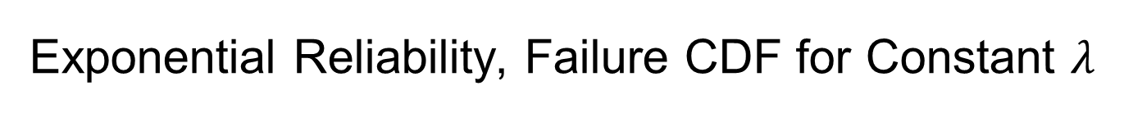
Exponential Reliability, Failure CDF for Constant $λ$
The Exponential expression shows these properties: R(t=0) = 1, F(t=0) = 0, Monitonic drop in R(t), Monitonic rise in F(t)
Probability
Exponential pdf
t

Slide 23
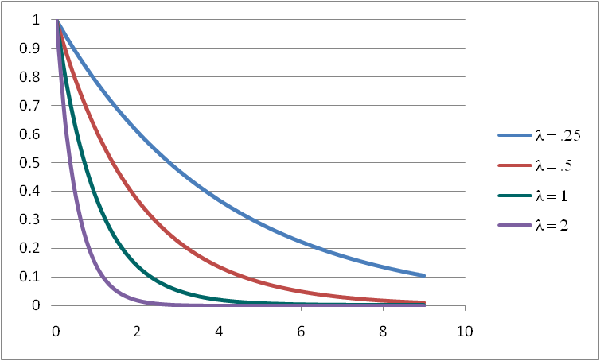
The Exponential Reliability CDF
more rapid drop but same shape
t
As λ increases, the reliability drops more rapidly with time toward zero. Slope magnitude is f(t) = λexp(-λt) with initial slope = λ at t = 0. The basic shape remains the same for all λ!
Notes:
The reliability function is plotted for three different values of its parameter lambda. From the graph it can be seen that as lambda gets larger, the reliability as a function of time more quickly approaches zero.

Slide 24
The Exponential CDF and PDF for constant λ
Check the properties or personality characteristics to show that f(t) is the pdf of (unconditional) failure corresponding to the properties including the slope of F(t), cdf of failure, and R(t), cdf of reliability. Check the range of values for f(t) throughout range for t from 0 to ∞.
Notes:
The CDF and PDF are obtained using the relationships presented in Chapter 2. Test your understanding of these functions by convincing yourself that they obey the properties of a CDF and PDF.

Slide 25
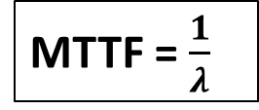
MTTF in terms of Constant λ
or,
So,
MTTF = $\frac{1}{λ}$
Note that:
This means 36.8% of all similar units (represented by an Exponential distribution) are expected to survive beyond t = MTTF.
And 63.2% of all similar units under the same conditions are expected to fail by t = MTTF.
Notes:
Using the definitional form of the mean of a probability distribution, the MTTF is found to be the inverse of the (constant) failure rate. It is only for the entialential distribution that this true. The failure rate is failures per time unit (e.g. .01 failures per day) and the MTTF is time units to failure (100 days to failure). If we set t = MTTF and find R(t = MTTF), it will always be .368 for this distribution. Why? This suggests that only 36.8 percent of all units will survive beyond the MTTF. Finding the mean of the exponential is easier if we integrate the reliability function. As an exercise, try it.

Slide 26
Variance and Standard Deviation (Constant λ)
= (MTTF)²
(unique for Exponential Dist.)
Note: the larger the MTTF, the more reliable a component and the larger the variability and therefore greater the uncertainty in its time to failure
Notes:
The variance is found through integration. Interesting, the standard deviation is equal to the mean. What can be concluded from this? Perhaps, the more reliable a component (as measured by its MTTF), the more variability in failure times will be observed.

Slide 27
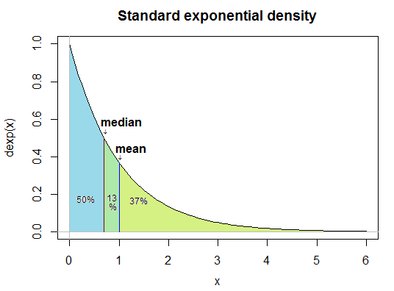
The Median Time to Failure (Constant λ)
To find the median time t_{med}, we set R(t)=0.5 and solve for t
50% of components are expected to survive beyond the median time (compared to 36.8 % for the MTTF).
Fun fact:
If you solve for t = t_{med}:
= 0.693∙MTTF
For the Exponential distribution, the median is always 69.3% of the MTTF because the mean is highly skewed by the tail to larger t values that place it at greater t than the median
Notes:
The median is easily derived and is always 69.315 percent of the mean. Of course only 50 percent of all components will survive beyond the median.

Slide 28
Design Life, t_{R} , for the Exponential Distribution (Constant λ)
For a given reliability value R, let
Design Life t_{R} corresponding to Reliability = R:
When R = 0.5, t_{med} = 0.693∙MTTF
When R = 0.99, t_{0.99} = 0.010∙MTTF
Notes:
Solving for the design life is similar to solving for the median. In fact, it is just a generalization of the median isn’t it? What happens if R = .5 in the above formula?>

Slide 29
Example Exercise #2
An electrical transmission line has been tested and found to have a CFR of λ = 0.001 defects per foot.
Find:
a. R(100)
b. R(1000)
c. MTTF, which here is mean distance to a defect
d. Standard Deviation
e. t_{med}
f. 90 percent design life
Notes:
It’s about time – an exercise for you to try. This should not be difficult. The answers follow.

Slide 30
Example Exercise #2- Solution
= Pr of no defect to 1000 ft
= Mean distance to defect
=Median distance to defect
90% Design Life: 0.9 Pr of distance w/o defect = 105 ft
Notes:
You should have gotten the correct answers. If not, go back to the beginning, do not pass go, and do not collect any money.

Slide 31
Memoryless Property of the Exponential, Constant λ
Conditional Reliability for working at t beyond T₀:
For the Exponential distribution, the conditional reliability equals the unconditional reliability. This ‘memoryless’ property, with behavior independent of history, implies that if we have two components, one 2 years old (T₀ = 2); another 10 years old (T₀ = 10), the Reliability or the probability that they will survive another 5 years (t = 5) is the same for both units and is equal to R(5).
A used unit of a component is expected to be just as reliable as a new unit!
Notes:
What about conditional reliability you ask! Here is an interesting result. The conditional reliability equals the unconditional reliability. This is just another manifestation of the “memoryless” property of the exponential distribution. This implies that if we have two components, one 2 years old (T₀ = 2); another 10 years old (T₀ = 10), the reliability that they will survive another 5 years (t = 5) is the same for both of them and is equal to R(5). The components do not age! Can you suggest some situations where this would be true?

Slide 32
Mean Residual Life, for the Memoryless Exponential
So for the Exponential model, the Conditional MTTF is numerically the same as the Unconditional MTTF, because λ(t) = λ is constant!

Slide 33
Example Exercise #3 -CFR Model
A certain type of surge protector is observed to fail at the constant rate of 0.0005 failures per day. Find:
a. The MTTF, median, and the standard deviation.
b. Find the Reliability during the first year; the second year; the second year given it has survived the first year.
c. The 90% design life.
Notes:
The inevitable student exercise.

Slide 34
Example Exercise #3- Solution
a. MTTF = 1/0.0005 = 2000 days (5.5 yr.)
Std Dev = 2000 days
t_{med} = 2000 x 0.693 = 1386 days (3.8 yr.)
b. R(365) = e^{- 365 x 0.0005} = 0.833
R(730) = e^{-730 x 0.0005} = 0.694
R(365|365) = R(365) = 0.833 (memoryless property)
c. t_{0.90} = - 2000 ln 0.90 = 210 days (7 mo.)
t_{R} = -1/λ∙lnR =-MTTF∙lnR
Notes:
Check your answers. Contact your instructor if things are not going well.

Slide 35

Example #4: Asteroid Return Period
“An asteroid, 2/3 of a mile across, can smash into the Earth at a high speed (which would cause a blast with the power of thousands of hydrogen bombs) within the next 300,000 years.” - Dave Morrison (NASA)
The mean time to a failure event= 300,000 yrs.
Assuming constant λ, calculate the probability that this asteroid is expected to collide with the earth for t > 70 years.
This is the logic of R(t) with Pr of failure event > t. Based on the above data, write an expression to calculate λ. R(t) = e^{- λt} = e^{- t /MTTF} = e^{- t /300,000}
R(70 yr) = e^{- 70 / 300,000} = 0.9998.
So the Pr of colliding with earth within 70 yr or ≤ 70 yr is the complement, 1–0.9998 = 0.0002
Event occurrence for T > t

Slide 36
System Reliability: Multiple Failure Modes
A failure mode is one way in which a component/system can fail.
Components usually have more than one failure mode, and each mode corresponds to a different failure distribution.
For example, a motor may fail due to a power surge or it may fail because of a wiring short.
Multiple failure modes can be modelled as a series system and the several failure modes in series can be modeled as the intersection, ⋂, of the reliability of each failure mode or single point failure.
Notes:
A failure mode is simply one manner in which a component can fail. Components may have several failure modes each having their own unique failure distribution. For example, a motor may fail due to a power surge or it may fail because of a short in the wiring. A complex system can have the failure of each of its components defined as a failure mode. The overall reliability of a component having several failure modes is simply the product of the reliability of each failure mode (assuming independence – no common cause).

Slide 37
Failure Modes in Series System
In a series connection: the only Path to success is that all of the n units are working and none of the n units fail.
If there are i number of failure modes: System Reliability, R_{S}(t) is:
where Ri⋂Rj = (Ri|Rj)(Rj) = (Ri)(Rj) if independent
R_{S}(t) decreases as n increases
Note: System Failure F_{S}(t), which is complement to R_{S}(t), is found from the complementary Union ⋃ operator because any unit failure causes system failure
F_{S}(t) increases as n increases
Notes:
A failure mode is simply one manner in which a component can fail. Components may have several failure modes each having their own unique failure distribution. For example, a motor may fail due to a power surge or it may fail because of a short in the wiring. A complex system can have the failure of each of its components defined as a failure mode. The overall reliability of a component having several failure modes is simply the product of the reliability of each failure mode (assuming independence – no common cause).

Slide 38
Failure Modes for a Series System
Let
Then assuming independence of all units in series, the system reliability is
where
The system Conditional Failure Rate, λ(t), is the sum of the individual rates of the independent failure modes, λ_{i}(t), in series .
Notes:
Using one of our favorite formulae from Chapter 2, we reach the relatively simple result that the system or overall failure rate is the sum of all the individual failure rates. What could be easier than addition? You follow the derivation, right?

Slide 39
Series Failure Modes and Constant Failure Rate, CFR
If a system consists of n independent serially related components each with CFR, then
_{S}
and
For λ_{i} constant for each component (CFR), the system rate of occurrence of failure (ROCOF), λ_{S}, is the sum of all constant λ_{i}, and is constant. The Reliability distribution of the series system is Exponential.
Notes:
Things get simpler if the failure rate or hazard rate function is constant for all failure modes. In this case the system failure rate is also constant (CFR) which then generates an exponential distribution. Serial related components or failure modes will be discussed some more in Chapter 5. However, for now, it simply means that if any component fails or failure mode occurs, the system will fail.

Slide 40
Example Exercise #5 - Series Failure Modes
An engine tune-up kit is a system consisting of 3 serially related and independent parts each having CFRs, or λ (in failures per mile) of 0.000034, 0.000017, and 0.0000086.
Find the MTTF, median time to failure, standard deviation, and reliability of the tune-up kit at 10,000 miles.
Where do you start this problem or what is needed first? What failure distribution should be used? How is the System λ_{S} calculated from the λ_{i} of each of its parts?
Notes:
Your turn!

Slide 41
Example Exercise # 5 Series Failure Mode (Solution)
Assume the parts are mutually independent:
Recall t_{0.5} = -ln(0.5)⦁MTTF
Notes:
Ahhhhh, the answers.

Slide 42
Parts Count Approach: What Assumptions?
An integrated circuit board consists of the following components each assumed, to have a CFR. What is the distribution?
Component a-Failure Rate, 10⁻⁵ b- Quantity (a) x (b), 10⁻⁵
Diodes, silicon 0.00041 10 0.0041
Resistors 0.014 25 0.3500
Capacitors 0.0015 12 0.0180
Transformer 0.0020 2 0.0040
Relays 0.0065 6 0.0390
Inductive devices 0.0004 12 0.0048
Total 0.4199 x 10⁻⁵
Therefore R_{sys}(t) = e^{- 0.4199x10-5 t} and MTTF = 1/0.4199 x 10⁻⁵
This is based on the assumption that all electronic components have CFR and behave independently, so the failure rates can be summed to obtain estimates for system failure rates.
Notes:
A military specification on the prediction of electronic components defines a parts count approach to finding system reliability. It is based upon the assumption that all components are CFR and that the failure rates can be summed to get the system failure rate. Electronic components are more likely to experience CFR than mechanical components. Why?

Slide 43
Assuming Independence and CFR Failure Modes
If all components have identical failure rates, then:
For what case is equal failure rates a reasonable approximation?
Answer: Similar components, under similar operation condition ranges.
Notes:
Things can get simpler (I know, it is hard to believe) if all failure modes or components have the same identical constant failure rate. Give some examples where this would be the case. In general for CFR components, the system MTTF is equal to the inverse of the sum of the component MTTF inverses. Of course, all we are doing here is adding the failure rates.

Slide 44
Failure Mode with Redundancy
Consider two identical components in parallel, each with a CFR, λ. For each component:
For the system of two independent, ~ identical components in parallel, the system fails only if both fail. So using the ⋂, intersection or AND operator:
fail
fail
Therefore,
Notes:
Components in a system may be related to one another in a serial fashion as discussed earlier or in parallel or redundant fashion. If two components are redundant, both must fail for the system to fail. R(t) is found by taking 1 – the probability that both components fail by time t. Why can we do this?

Slide 45
Redundancy: Failure Rate Function
For the system pdf:
So
Note that λ(t) for the system is not constant. Instead of a CFR process like each of its 2 units, λ(t) is an IFR process.
Notes:
For a system consisting of two redundant and CFR components, the hazard rate function is no longer CFR. Observing the value of the hazard rate function as t get larger, it can be seen that the failure rate approaches a constant that is equal to common failure rate of the two components. What a neat result!

Slide 46
Redundancy, CFR and MTTF for
From the basic expression for MTTF for the system:
By adding a single identical component in parallel with the first component, a 50% increase in the System Reliability is achieved providing the component behavior is independent. Therefore, the actual Reliability, not fully independent, will be less than this amount and will depend on the extent to which the component behavior is mutually dependent due to sensitivity to certain conditions, such that if one component fails the other is more likely to fail also.
If the components are fully dependent, no additional reliability is gained by the parallel system and with greatly increased costs.
Notes:
The MTTF of a system composed of two identical and CFR components is found by integrating the system reliability function. The MTTF of this redundant system is 1.5 times the MTTF of each of components.

Slide 47
Example Exercise #6, Redundant Units
A tested microwave transmitter has shown a constant failure rate of 0.00034/hr = λ.
MTTF = 1/λ = 2941 hr for one transmitter unit
R(t) = exp(-λt) = exp(-0.00034t)
R(t = 30 day) = R(t = 30x24hours) = 0.783
T_{0.95} = -ln0.95/0.00034 = 151 hr
Add a 2nd redundant and independent transmitter in parallel with the 1st, so system reliability for 30 days or 720 hr is significantly higher compared to the single unit.
MTTF_{S} = 1.5/0.00034 = 4412 hr, which is 1.5 times the
MTTF = 2941 hr for a single unit, if independent.

Slide 48
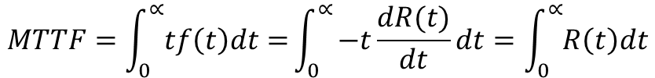
Review
R(t)=Pr(T>t)
F(t) = Pr(T<t) = 1-R(t)
$$MTTF=\int_{0}^{∝}{tf\left(t\right)dt=}\int_{0}^{∝}{−t\frac{dR(t)}{dt}dt=\int_{0}^{∝}{R\left(t\right)dt}}$$

